Slide 1



What, Where, and When in DHIS2
Introduction to DHIS2

Slide 2


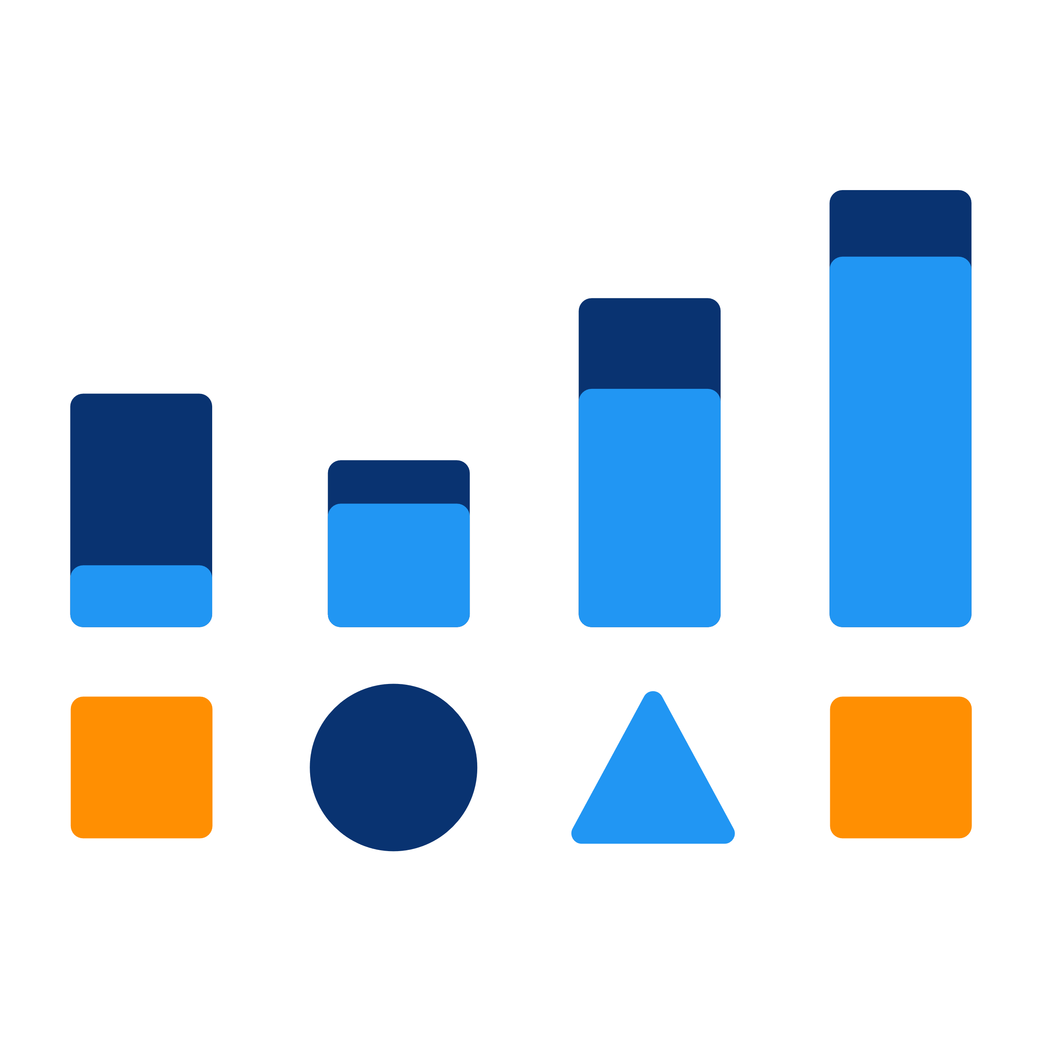


Collection
Validation
Analysis
Presentation
Notes:
In the +feature overview section, you learned that +DHIS2 is a web-based platform offering tools for +collection, +data validation, +analysis, and +presentation of data.

Slide 3

How are data organized within DHIS2?
Notes:
But, how are data organized within DHIS2 to enable these capabilities?

Slide 4



3 building blocks
1.
Data elements
2.
Organisation units
3.
Periods
Notes:
In this video, we will take a look at the +three building blocks or data dimensions associated with all aggregate data values in DHIS2. They are called +"data elements," +"organization units," and +"periods."

Slide 5

3 building blocks
“What”
Data elements
Metadata
“Where”
Organisation units
Classify
Organize
“When”
Periods
Notes:
These three data dimensions are +referred to as +meta-data in DHIS2 as they provide information we can use to +classify and +organize the data. "Data Elements" +represent +“what” is being measured, "Organization units" +refers to +“where” the data were collected, and Periods +represent the +“when” dimension.

Slide 6







3 building blocks
Data elements
Organisation units
Periods
SMS
API
Notes:
While data +are routinely entered using data +entry apps, these 3 dimensions are pre-defined. +Together, +they provide relevant context for the data to be understood.

Slide 7
Example: Adding context to a data value
“What”
“Where”
“When”
39
Notes:
Let's take a look at the+ example below. If you have a data value of 39, this value on its own does not give us enough context. By attaching the +“what”,+ “where” and +“when” dimensions to the state of value we have a better idea of what it represents.

Slide 8
Example: Adding context to a data value
“What”
Positive malaria cases
Data element
39
“Where”
Namchala Health Centre
Organisation unit
October 2020
“When”
Period
Notes:
Let's suppose that the value 39 +represents the number of +positive malaria cases. This represents what is being measured, the +Data Element or the “+what” dimension. These +cases were reported in +“Namchala Health Centre”. This constitutes the geographical frame, the +Organization Unit or the +“where” dimension. And lastly, we +need to add a time frame, in this case, +“October, 2020”, the +Period or the when dimension.

Slide 9


Example – 3 building blocks
“What”
“Where”
“When”
39
Notes:
You can see when we attach these three dimensions to tha data value, you can now understand what that value represents: there were 39 cases of +malaria in +Namchala Health Centre in +October 2020.

Slide 10
Metadata
“What”
“Where”
“When”
Data elements
Organisation units
Periods
SMS
API
Notes:
This approach +to classifying data separates +DHIS2 from many of the traditional health information softwares.The fact that every data value within DHIS2 +will consist of these +3 core dimensions independent of any particular source or data collection form means that +many different data sources +can be integrated into a one single DHIS2 database.

Slide 11
Summary
1.
“What”
Data element
2.
“Where”
Metadata
Context
Classification
Organisation unit
Analysis
3.
“When”
Integration
Period
Notes:
In summary, we learned that +each data value in DHIS2 will have at least these three dimensions associated with it: +Data Element -the “what,” +Organisation unit -the “where” and +“Period” -the “When”. Together they are +considered +“meta-data” because they +provide +context to data values and enable us to +classify and +analyze the data as well as enable +integration of data from various sources

